Slide 1

JEDI Training Group 1

Slide 2

Our Team
Notes:
Time – 2 mins

Slide 3
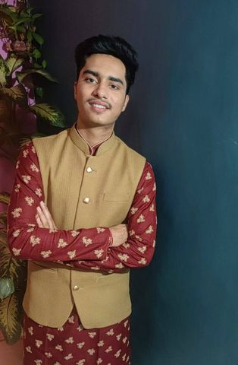
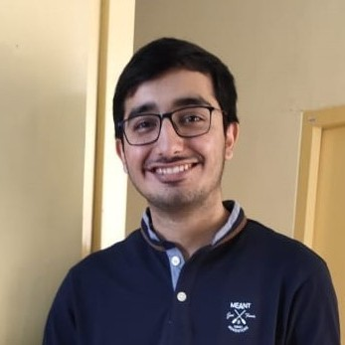

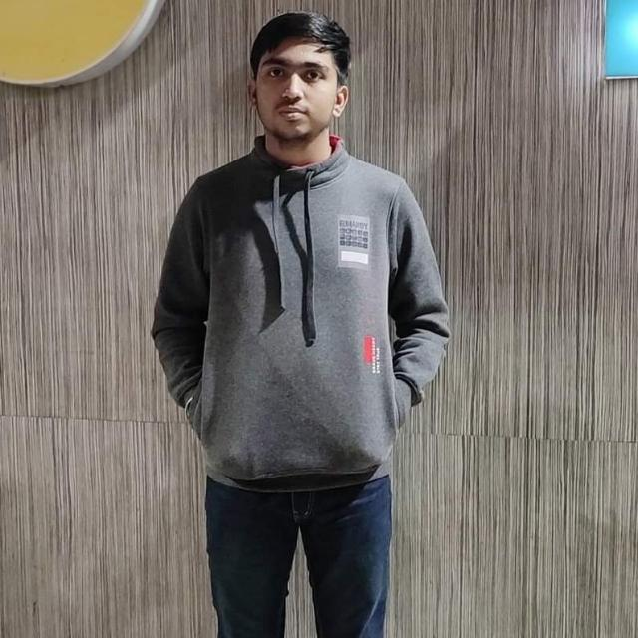
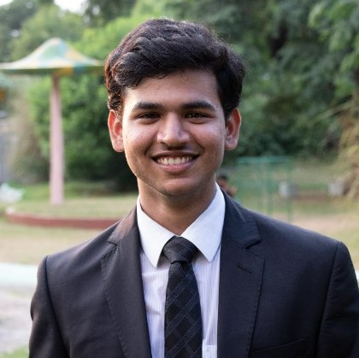
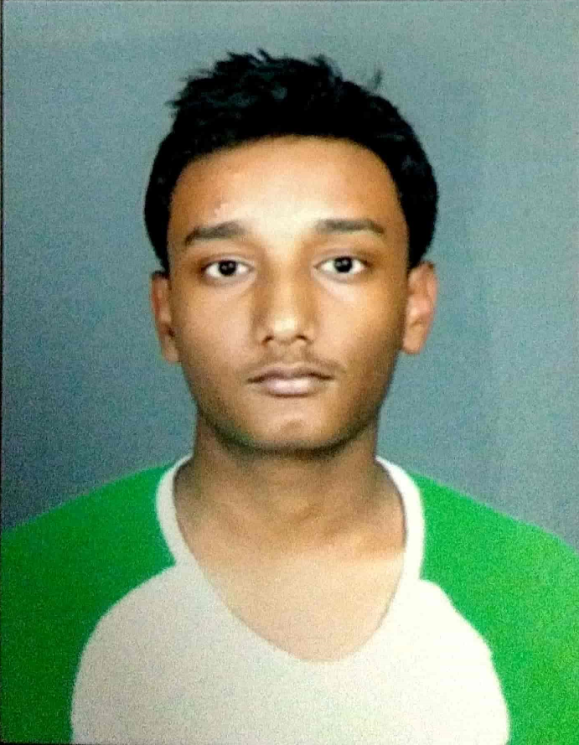
Nayan
Developer
Dhruv
Group Leader + Developer
Geeth
Developer
Ashutosh
Developer
Kaustubh
Developer
Mohit
Developer

Slide 4
The Ask – Where we started?
…..

Slide 5
Framework for 8 days
1 and ½ weeks training
Organised plan to enhance our software development skills from simple unix, git commands to making POS, REST Applications.
We started with a problem statement, modeled the problem using UML, designed POS Application for it and then converted that into a REST Application using Apache Jersey and DropWizard.
Topic wise tests were conducted for each topics to assess our learning.
Constant feedback on our work was given by our mentor to make the appropriate changes to refine our work.

Slide 6
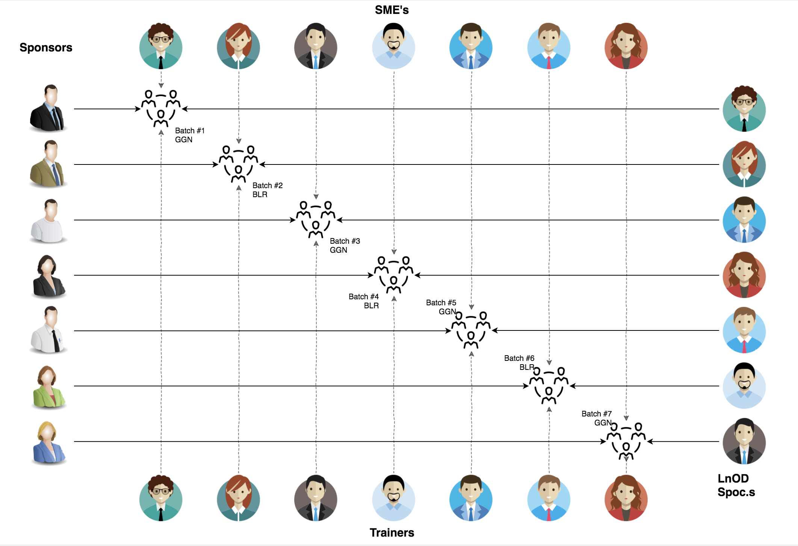
Stakeholders
Sponsors
Flipkart
SME
Amit Balyan
Deepika Gajraj
Kushboo
Trainers
Amit Balyan
Training coordinators
Pooja Sudarshan
Deepika Gajaraj

Slide 7

Agenda
01
Our Journey
02
Our Team
03
Team Structure
04
Problem Statement
05
Engineering Practices
06
Tech Stack
07
Development
08
Challenges & Learnings
09
Demo
10
Questions
Notes:
Time – 1 min

Slide 8

Our Journey
Notes:
Time - 2 mins

Slide 9
ACTION PLAN
 | Modules | Description
Days 1, 2, 3 | UNIX GIT UML Diagrams | Understanding Unix and Git commands Requirement understanding and diagram design
Days 4, 5, 6 | Core Java 8 Interfaces Collections Exceptions Packages SQL | Developing a POS Application using Java and MySQL. Understanding Java 8 features and collections
Days 7, 8 | Jersey and DropWizard | REST API Development using Jersey and DropWizard framework

Slide 10
Demo
Testing
Process
5
project Demo
Tools
4
Testing on Console, REST client such as Postman
Comprehend
3
Architecture Design and Development
2
Deciding the Technology stack for console and REST API development
1
Understanding Project Requirements and Goals

Slide 11
Our next journey starts
NOW
Notes:
Time – 1 min
Swati

Slide 12
8 Days
80 Hours
4800 Minutes
288000 Seconds
LIMITLESS KNOWLEDGE

Slide 13

Project Goals
Notes:
Time – 3 mins

Slide 14




Our Vision
Our vision was to create a Course Management system that allows students to carry out their semester registration, professors to work on Course related activities and the admin to monitor the whole application.
1
2
Quality
Security
3
4
Interactivity
Speed
Notes:
User satisfaction and brand value

Slide 15

Engineering Practices
Notes:
Time – 5 mins

Slide 16



POS Application
Client Layer
Business Layer
Data Access Layer
DATA
HTTP Request
HTTP Response
Layered Architecture

Slide 17
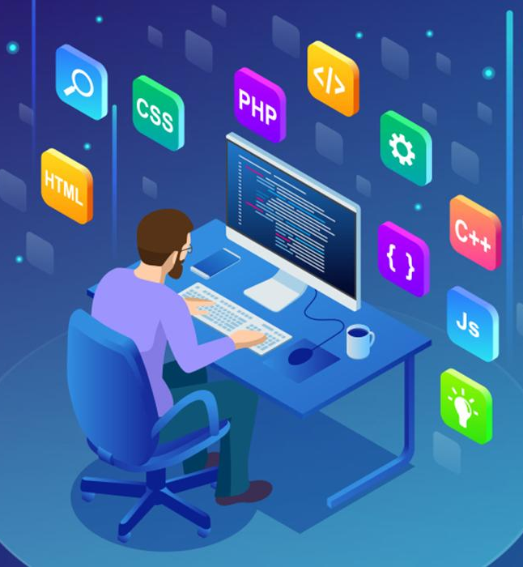
Tech Stack
Notes:
Time – 2 mins

Slide 18





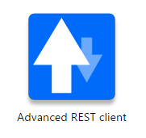







Designing
Backend
Testing
Data
SCM
UML
Core Language
Tools
SQL Database
Code Collaboration
Framework
Application Server
Notes:
Time – 1 min
Java
Maven
DropWizard
MySQL
Jersey
GitHub
Postman / ARC (Check it)
StarUML / Dia / Lucid Charts
List
Design
Backend
Testing
Tools

Slide 19

Development

Slide 20
Requirement Understanding
Research and analysis
Estimation
Implement client, service and Dao layer
UML Modeling
POS
Application
DropWizard
REST API
Convert POS client to REST API’s
Notes:
Time – 1 min

Slide 21

Challenges & Learnings
Notes:
Time – 2 mins

Slide 22
 | Challenges | Learning
Days 1,2,3 | Understanding the problem statement UML diagram conventions | Linux Commands Git commands UML Diagrams
Days 4,5,6 | Installation softwares on multiple environments POS application development using layered architecture Collaboration issues such as merge conflicts in Git | Core Java 8 SQL
Week 7,8 | Migration from POS application to RESTful api’s Resolving jar and version dependencies Jersey validation Running Apache TomCat server | REST API development using Jersey and DropWizard Maven DropWizard

Slide 23

Demo
Notes:
Time –
Architecture – 5 mins
NFR Dashboard – 3 mins
Demo – 10 mins
1. Show the Responsiveness and Wave tool first

Slide 24

Questions
Notes:
Time - ?

Slide 25
Thank you!
Notes:
Time – After this show the testimonial video. 1 min

